Slide 1
4G Telecommunications
Huge data transmission without wires!
Cameron Smith
Capstone Team 1
Notes:
Intro say your name, team, project, and subsystem
Mention that wires are actually involved
5G exists but not for this presentation

Slide 2
Let’s talk about the same thing
Notes:
Be using the same terms
Same ballpark and game

Slide 3
Vocabulary Clearing
3G is “3rd Generation” of cell network.
4G is “4th Generation” or successor to 3G cell network.
4G LTE is NOT 4G
GSM, WiMax, 3G, 3.5G, 3.9G, 3.95G, and Advanced 4G are NOT 4G
THESE ARE NOT 4G!
Notes:
Stress that 4G and 3G
Naming scheme for some are dumb
Cellular broadband network uses radio frequency waves to transmit data

Slide 4
A Brief History
2002: Envisioned by International Telecommunication Division (ITD) and US Military
2004: 3G was well-established but Japanese co. DoCoMo began work on LTE
2006: American co. Sprint enters the race for new generation of telecommunications
2007: DoCoMo’s first trial of LTE achieved 100 Mbit/s motion and 1 Gbit/s stationary
2009: Swedish co. TeliaSonera deploys to first ever network to be labeled as “4G”
2010: Sprint releases the world’s first commercially available 4G cell phone
2023: 4G is still in use today and is expected to remain for rest of the decade at least
Notes:
US Military is DARPA
2007 DoCoMo proved that new hardware could be pushed way beyond expectations
Sprint invested $5 billion WiMax infrastructure
TeliaSonera actually could only get 50 Mbit/s down and 5 Mbit/s up which doesn’t align with today’s standards.
Verizon followed Sprint into 4G that same year

Slide 5
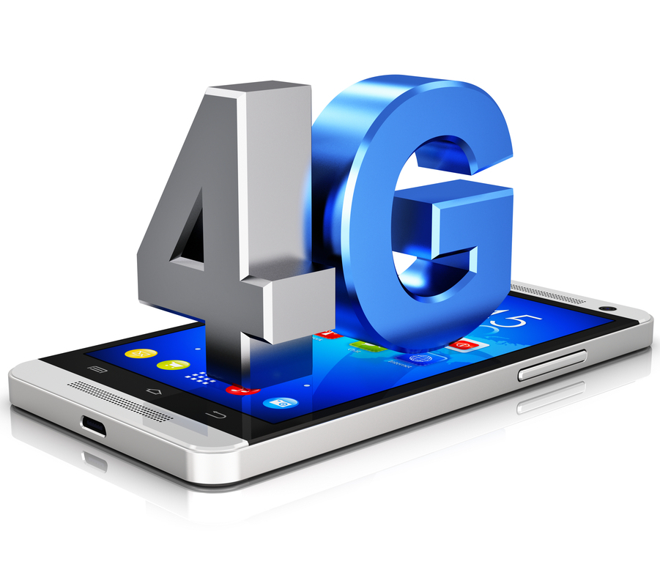
Defining 4G as a Standard
Must be entirely Packet-switching basis
Interoperable with existing standards
Must reach speeds of 1 Gbit/s while client is physically stationary
Must reach speed of 100 Mbit/s while client is physically in high speed motion
Scalable channel of nominal 5-20 MHz up to 40 MHz
Frequency bands: 600 MHz, 700 MHz, 1700/2100 MHz, 2300 MHz, and 2500 MHz
IP Telephony
Notes:
Defined by International Mobile Telecommunication Advanced Standard (IMT-A) made by International Telecommunication Union (subsidiary to IDT from last slide)
Packet switching is more like a regular computer
No circuit switching involved
Interoperable means it can fall back to old standards to still send data LTE, 3G, GSM
Frequency bands can change and are different from region to region.
IP Telephony is a method of sending voice data through along the Internet with packeted data

Slide 6
So, You Wanna Send Data Using 4G?
My Perspective:
Turn on my phone and go to messaging app
Type “You smell like dog water brother”
Hit Send
Wait for reply
Wait for reply
Go to Dairy Queen
My Friend’s Perspective:
Phone is off
Phone is off
Phone receives message
Friend turns on phone and sees message
Laughs
Doesn’t respond

Slide 7
So, You Wanna Send Data Using 4G?
My Phone’s Perspective:
Power On
Format packet data for transmission
Read SIM data
Send service request to local base station
Ack/wait then transmit target SIM/MAC
Base station rec then contact Service Gateway
Service Gateway shares data with service providers and waits for approval
Approved transmission is relayed to PDN Gateway
PDN Gateway proceeds node hopping to target
Ack/wait for target confirmation
Send Ack and path to target back to my phone
My phone sends data packet to friends phone
Continue until all data is sent
Ack/wait then send kill signal
Close task and power off
My Friend’s Phone’s Perspective:
Nothing
Nothing
Nothing
Nothing
Nothing
Nothing
Nothing
Nothing
Nothing
Receive incoming data request
Receive Ack. Send Ack back
Receive packet. Strip packet for actual data
Continue receiving and stripping
Ack data completed transmission
Format data and notify my friend
Notes:
That’s a lot of steps to tell my friend he stinks
Subscriber Identity Module (SIM) and Media Access Control (MAC)
Service Gateway is like a router but not really
Packet Data Network Gateway is like traffic cop telling people where to go in the Internet

Slide 8
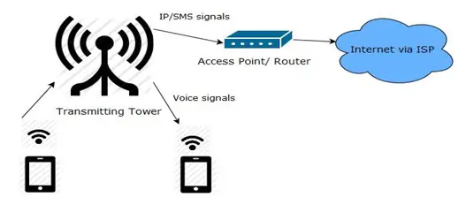
Notes:
This looks a lot more simple but shows the same thing with steps excluded
Very simplified look is that there is just one middle man being the tower a.k.a the base station

Slide 9
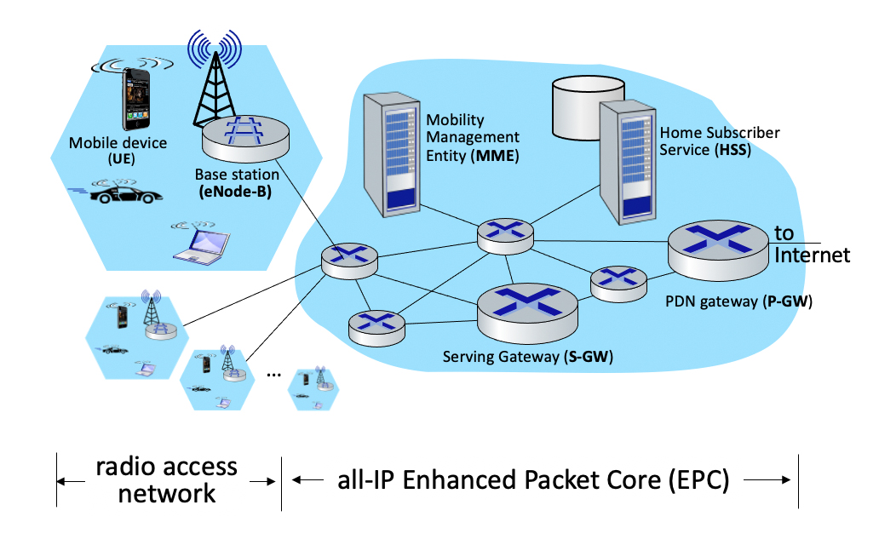
Notes:
Service Gateway is like a router but not really
The big bubble is mostly just Service Gateways which help direct the packets to where they think they should go
Packet Data Network Gateway is like traffic cop telling people where to go in the Internet
MME and HSS are from your cell service provider like Verizon

Slide 10
References
Vilches, J. (April 29, 2010). "Everything You Need To Know About 4G Wireless Technology". TechSpot.
"4G Mobile Broadband". Sprint.
"DoCoMo Achieves 5 Gbit/s Data Speed". NTT DoCoMo Press. February 9, 2007.
"4G Coverage and Speeds". Sprint.
“4G”. Wikipedia
“How Internet Works on Mobile Devices”. Engineers Garage. https://electronics.howstuffworks.com/4g.htm#pt3
“Exploring the Network Routing Process”. LearnCisco. https://www.learncisco.net/courses/icnd-1/lan-connections/packet-delivery-process-at-l3.html
“How 4G Works”. How Stuff Works LLC. https://electronics.howstuffworks.com/4g.htm#pt3
"An Introduction to LTE". 3GPP LTE Encyclopedia.
Notes:
Knock em’ out John

